Slide 1
Promotion of NSDI in Japan
2016-11-14 SSGCC
Hidenori FUJIMURA
GSI International
Photo by Kikuchi City, licensed under CC BY 4.0 International
Notes:
Now I am going to make the second presentation for today. I would like to talk about the promotion of NSDI in Japan.

Slide 2
Promotion of NSDI in Japan
At the level of the entire government
NSDI Steering Committee
NSDI Working Groups
At the level of national geospatial information authority
GNSS CORS Infrastructure
Web Maps (geoportal)
Moment of truth as in disaster response
Notes:
I can talk on the two levels; first at the level of the entire government, and second at the level of national geospatial information authority.

Slide 3
NSDI Steering Committee
Chair: Deputy chief cabinet secretary
(parliamentary and administration)
Acting: Assistant deputy chief cabinet secretary
Members: Bureau directors of relevant agencies
including director-general of GSI
Secretariat: Cabinet, MLIT* and GSI
* National and regional policy bureau, ministry of land, infrastructure, transport and tourism
NSDI steering committee*
* Committee for
the advancement of Utilizing Geospatial Information
Geographic information systems WG
Satellite positioning WG
Geospatial project promotion WG
Review Teams
Promotion Teams
RT on protecting personal information and intellectual property
RT on national security
RT on development and update of fundamental geospatial gata
PT for utilization of geospatial information center
PT for advancement of disaster prevention system
PT for IT-based agriculture, forestry and fisheries
PT for vitalization of communities and small and mid-size enterprises
PT for overseas development
Notes:
The NSDI steering committee of Japan is chaired by deputy chief cabinet secretary. The director general of GSI is a member of the committee, and GSI acts as one of the secretariat member of the committee.
Under the steering committee, we have working group on geographic information systems, satellite positioning, and project promotion. There are several review teams and promotion teams under the working groups.

Slide 4

NSDI Basic Plan
31 pages
Not actually a “bottom-up” document. But reflects existing work of relevant organisations incl. GSI.

Slide 5
Geospatial Infrastructure
GSI broke down our contribution to NSDI into 3 components.
ownership and involvement matters, to implement NSDI.
NSDI
National Spatial Data Infrastructure
Geospatial Society
Various application by open innovation
Disaster Response as the Moment of Truth
(1) GNSS CORS Infrastructure
(2) Institutional Arrangement
(3) Web Maps
Geospatial Infrastructure
Open data service, often by open source software

Slide 6
Winning at the moments of truth
The best way to promote NSDI components is to provide the best performance in a most relevant use case.
In the case of GSI, the use case was the disaster response.

Slide 7
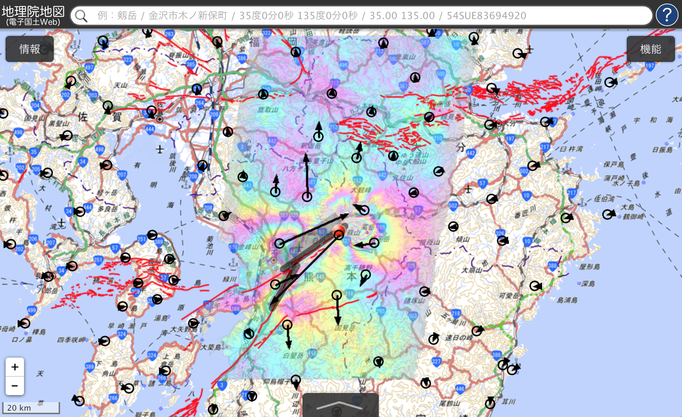
Disaster Response
Disaster Response is the Moment of Truth for Geospatial Infrastructure
high demand for scalability, timeliness, and accuracy.

Slide 8
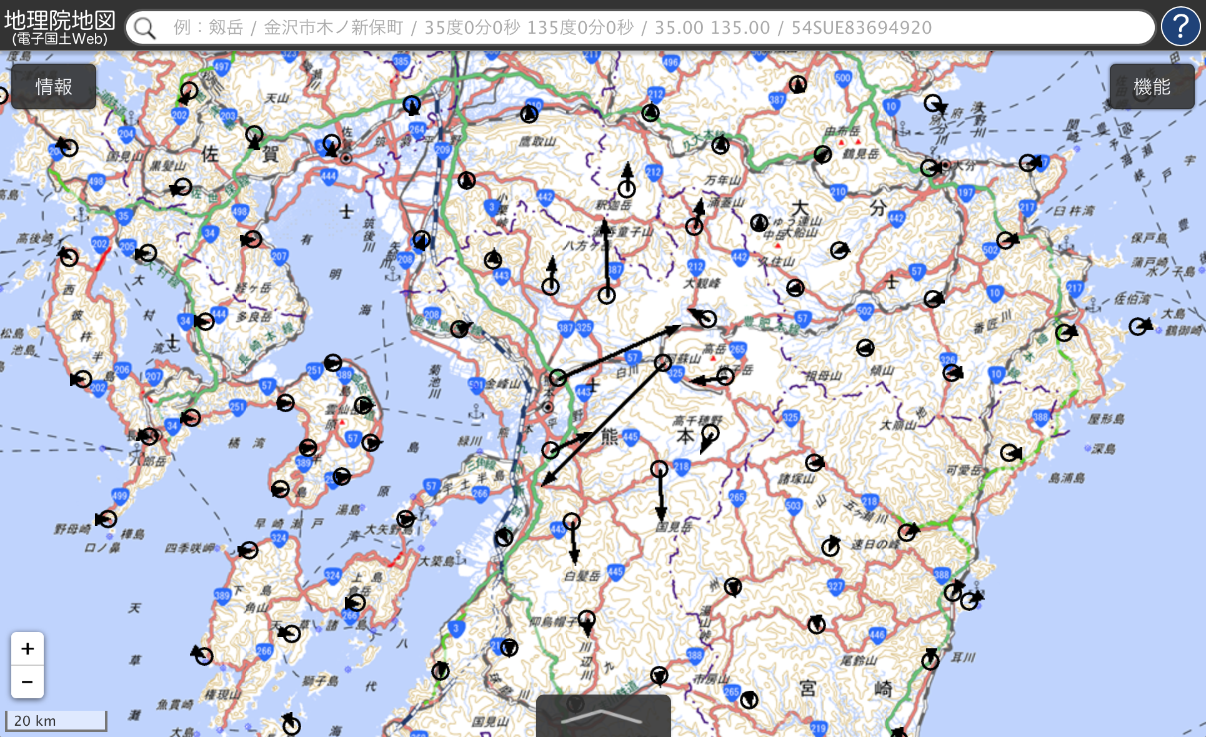
Horizontal movement of GNSS CORS

Slide 9
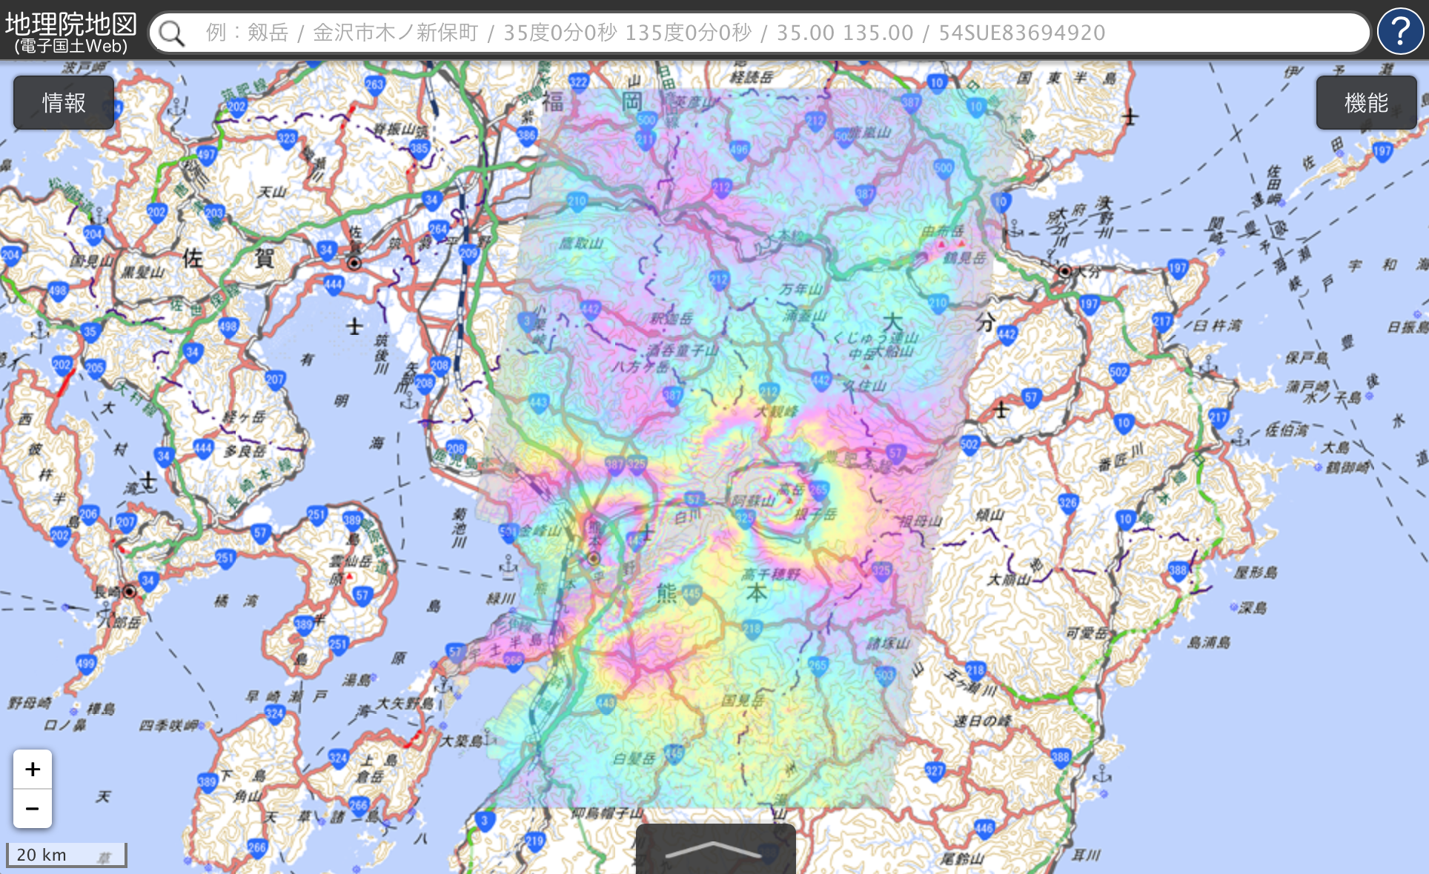
Satellite SAR Interferometry

Slide 10
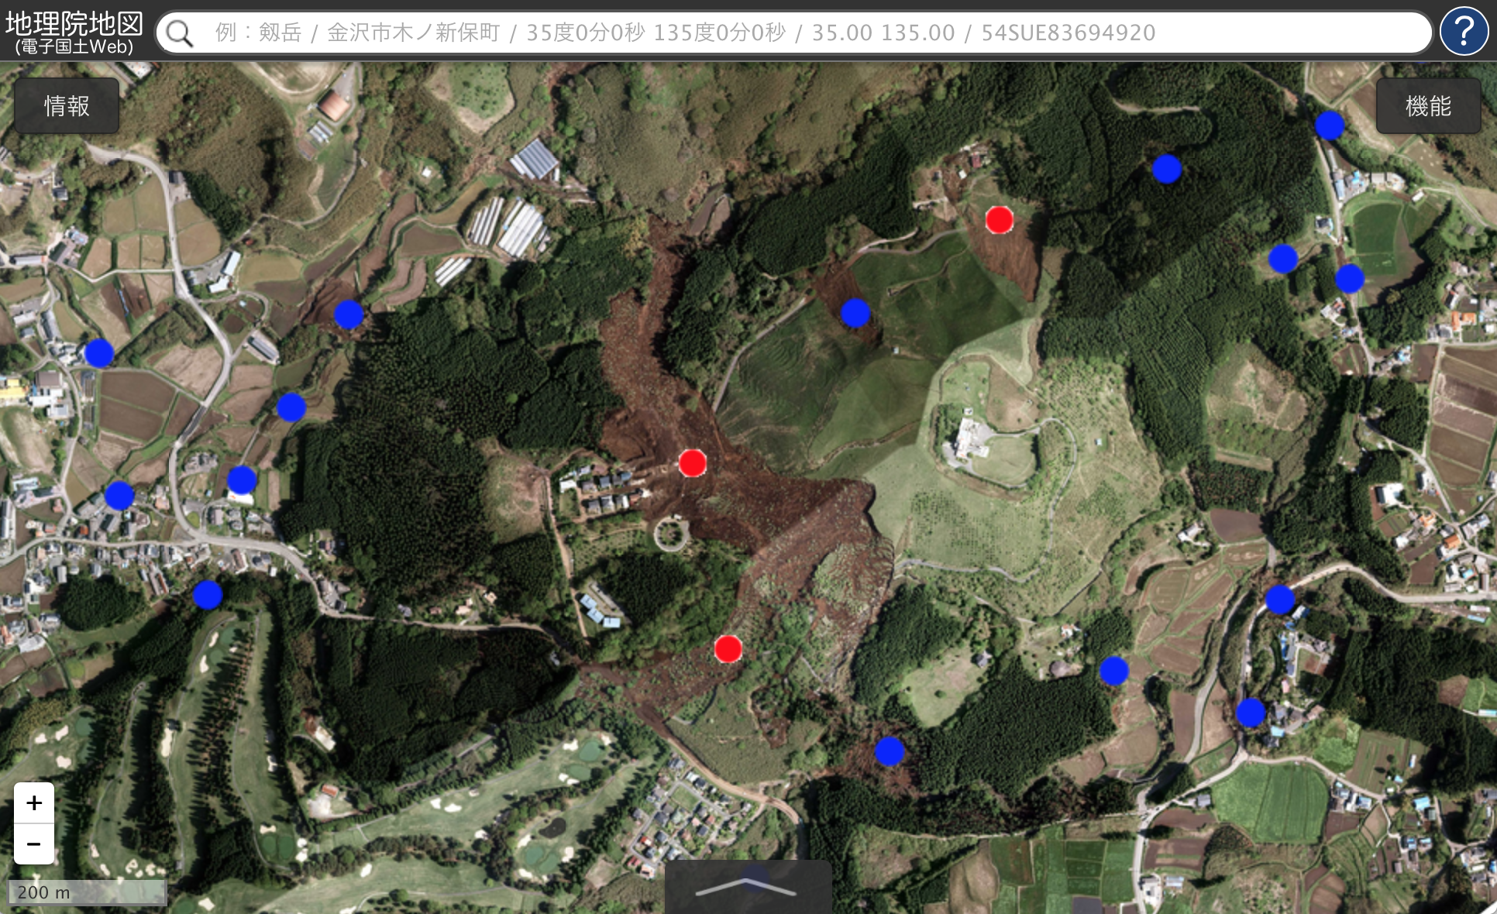
Detection of landslides

Slide 11
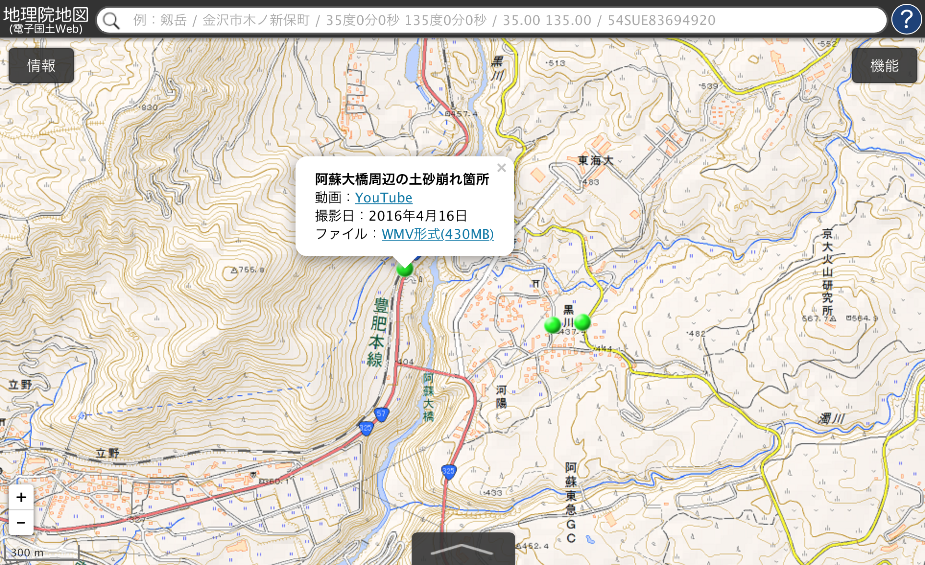
UAV (drone) video

Slide 12
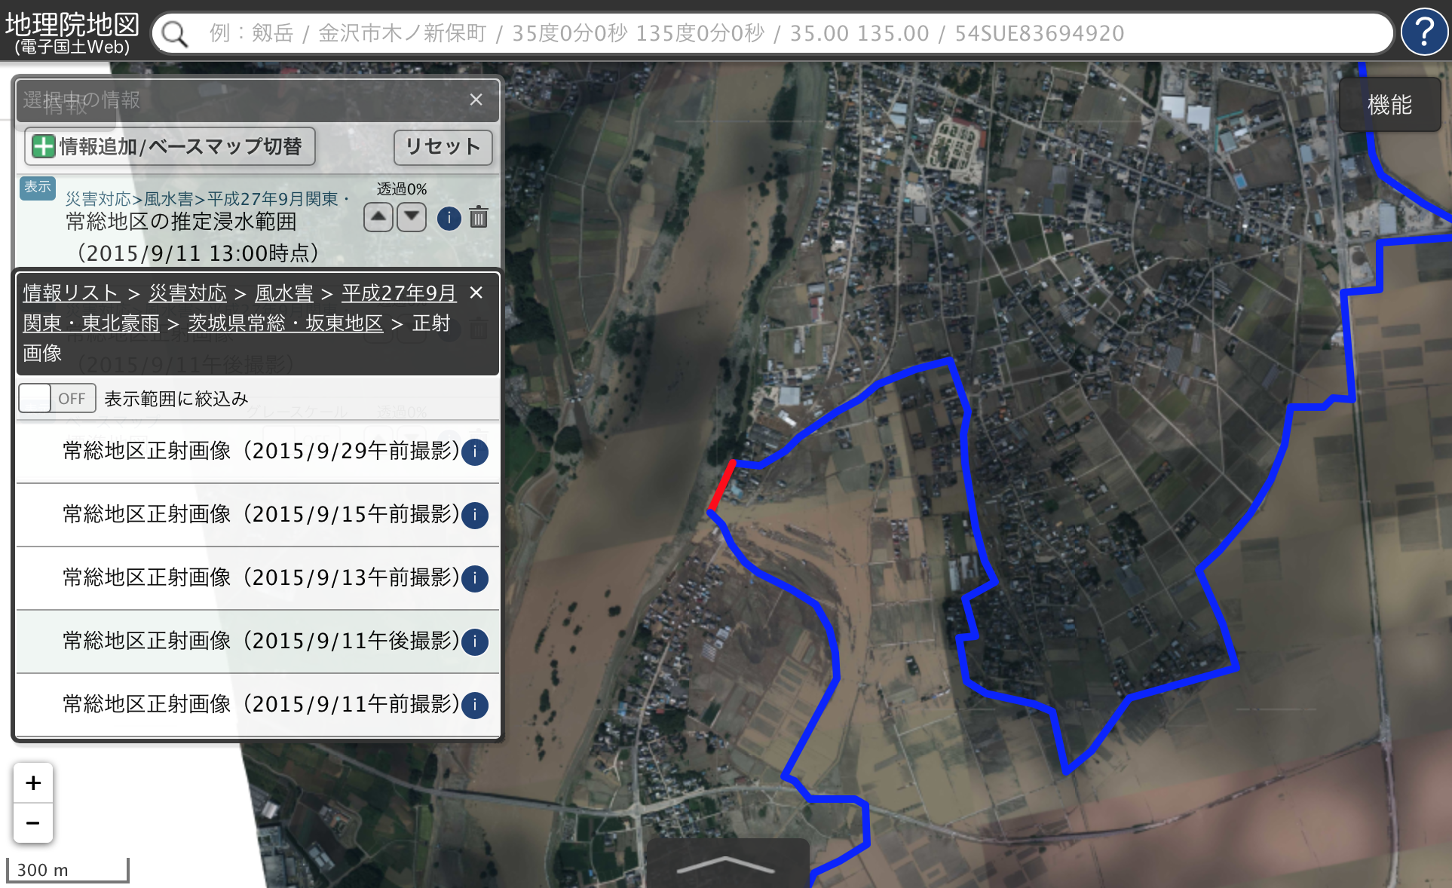
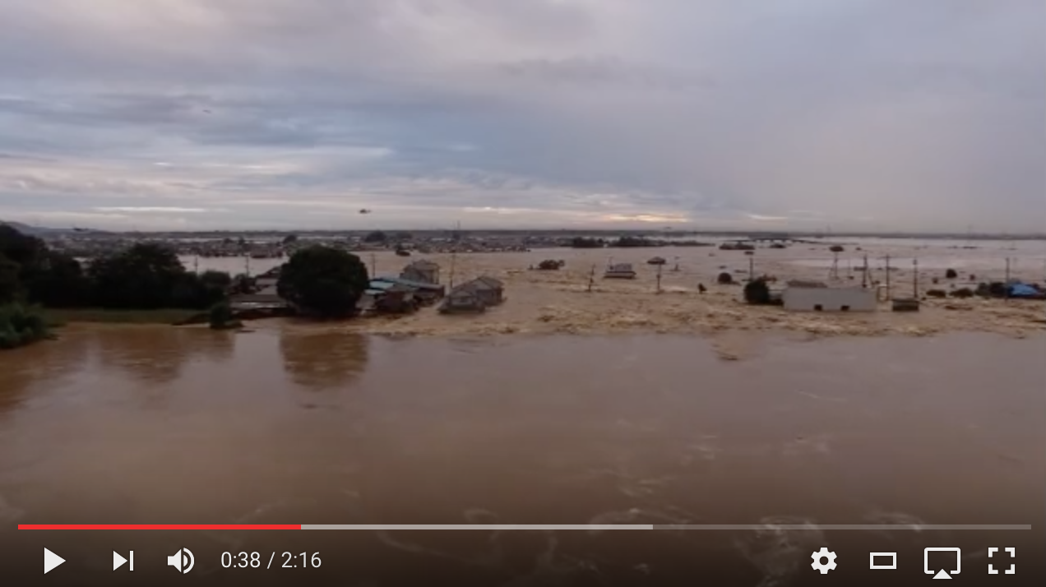
Flood in Joso city, 2015-09

Slide 13
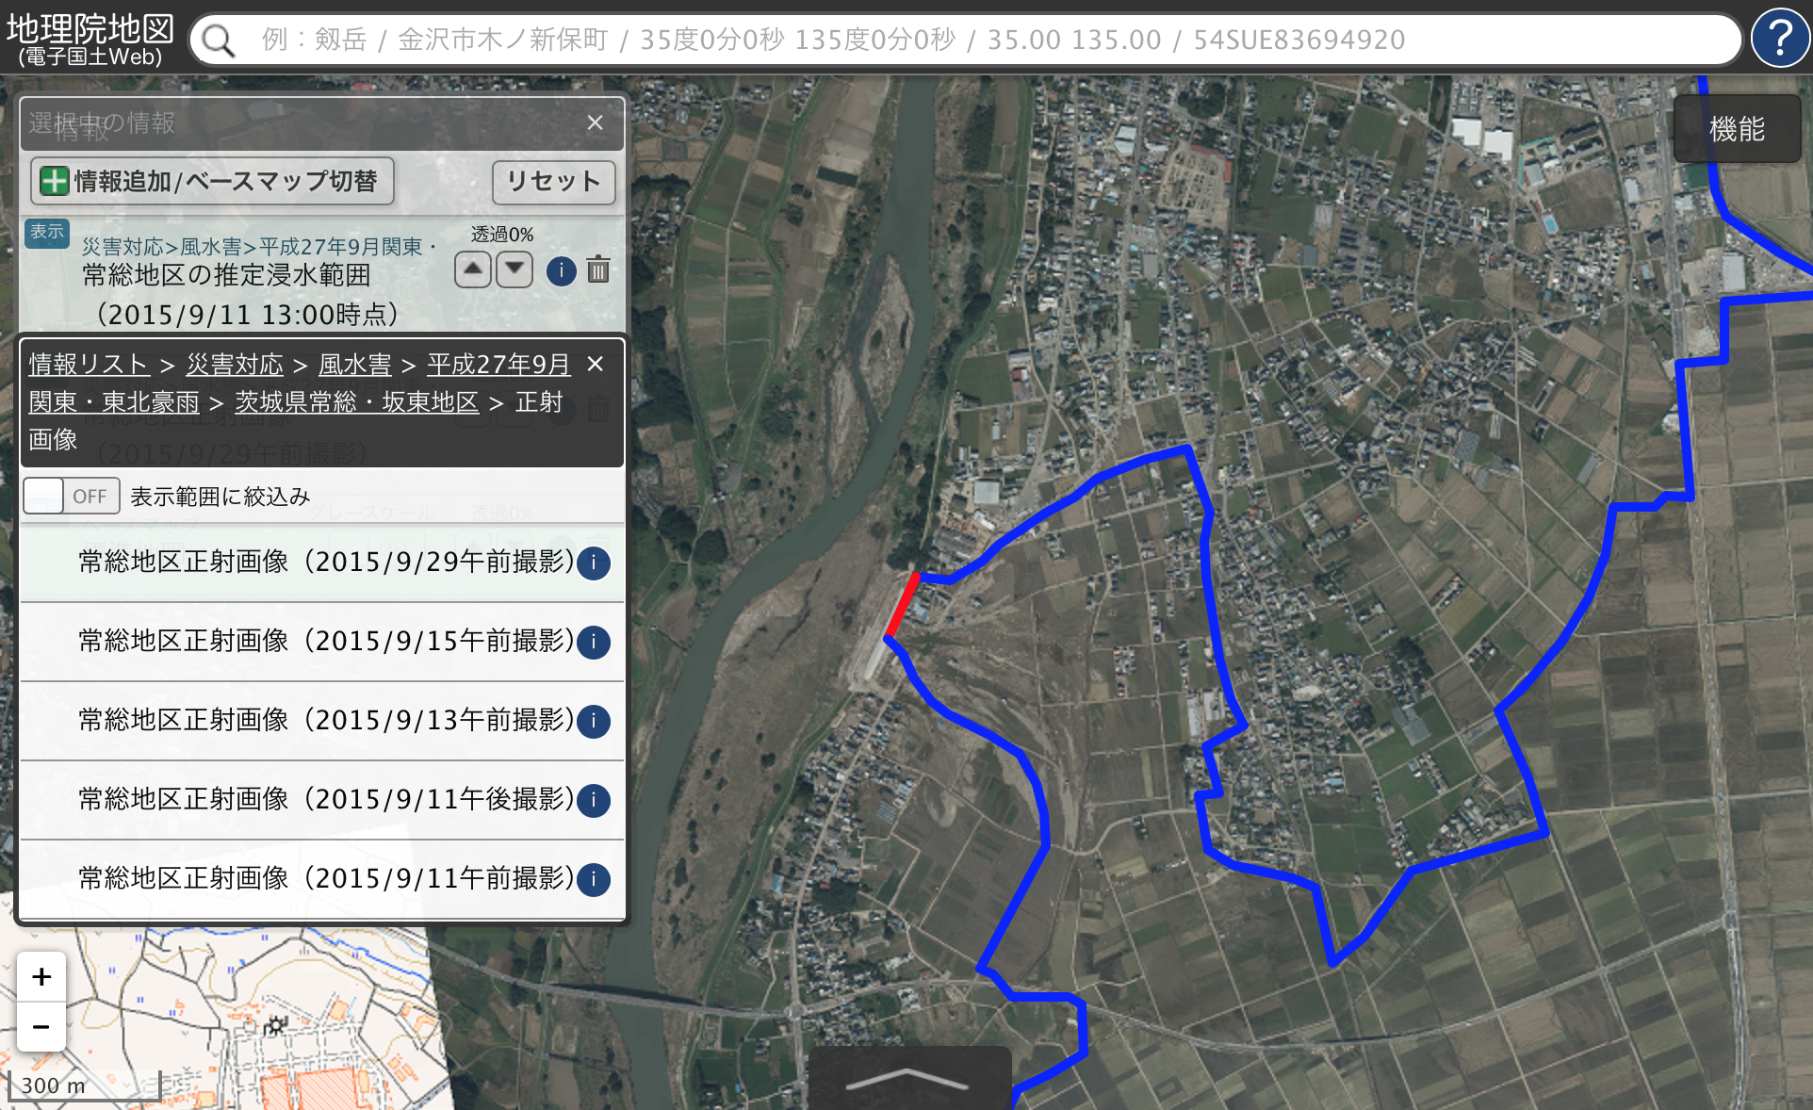
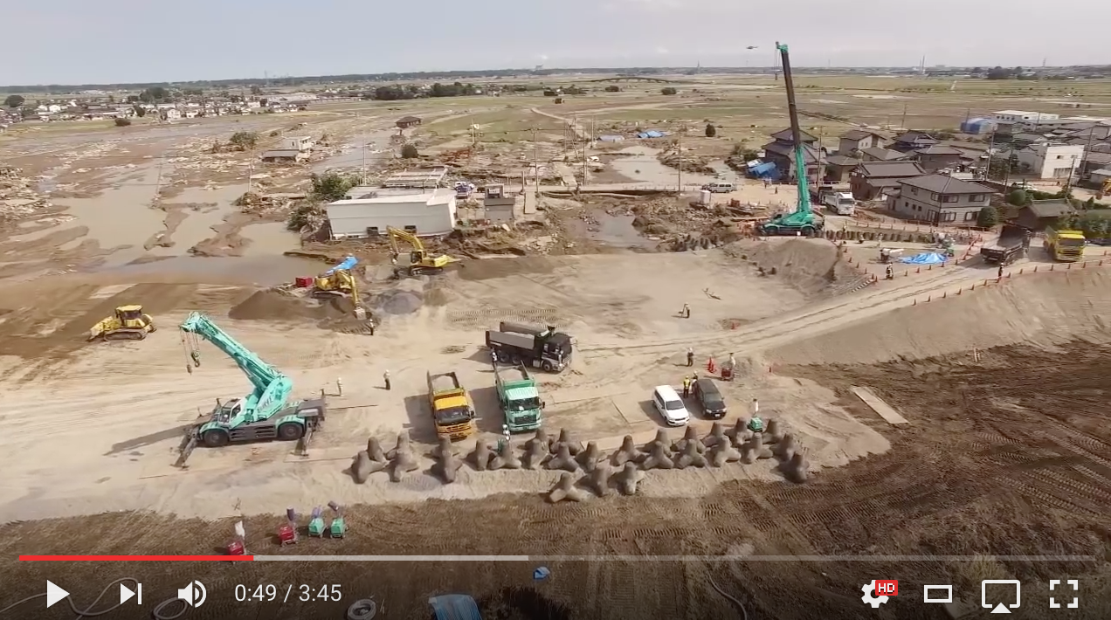
Important to record the recovery, too

Slide 14
A proposal for promoting NSDI
Identify a most relevant use case of your NSDI component.
Try to provide a best performance for the identified use case.
If people need something, it is necessary.

